Slide 1
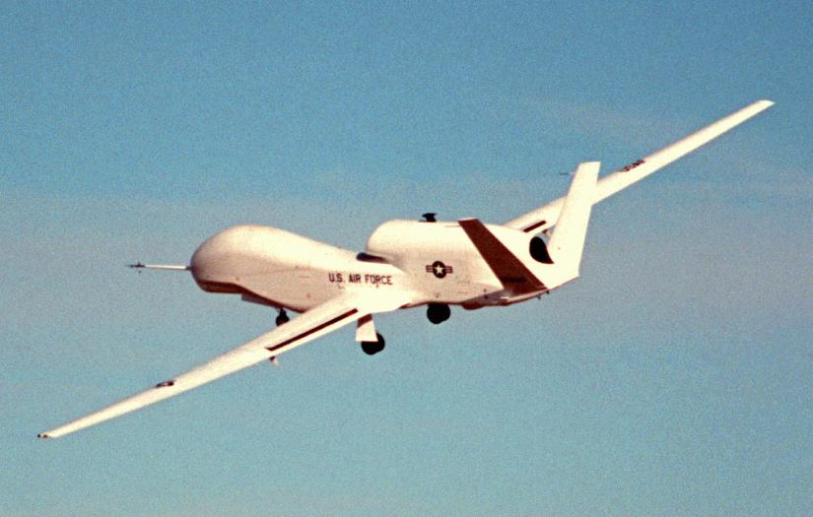

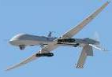
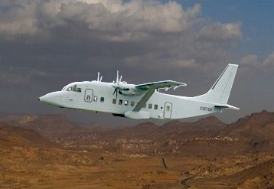
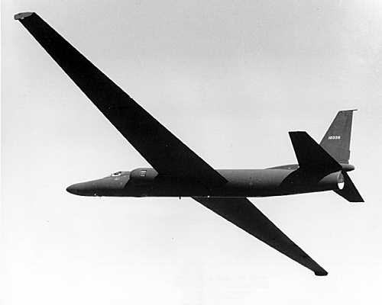
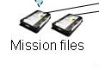





CHLOE Architecture/Data Flow (Rev 5, 5 Aug 08)
MIT/LL
Cluster
Processed
J2K
Predator (surrogate)
SAR/MTI, NFOV Video
Constant Hawk
WALF EO Imagery
Proc
Post-flight
Data Offload
.mhs
Processed
J2K
J2K (MIT/LL)
Global Hawk
U-2
EO Imagery
.mhs
5
.mhs
J2K (Pixia)
.mhs
J2K (Pixia)
1
Pixia
Processor
GCS
GCS
Srvr
3
J2K (Pixia)
Proc
Proc
.nui
6
7
8
.nui
.nui
Isilon
Store
Pixia
Encoder
4
J2K (MIT/LL)
.mhs
.nui
J2K
MPEG
NITF2.1
4607
MPEG
NITF2.1
4607
MPEG
NITF2.1
4607
.mhs
.nui
J2K (Pixia)
J2K (MIT/LL)
MPEG
NITF2.1
4607
2
NITF2.1
CFE (SECRET/4 EYES)
.mhs
.nui
J2K
MPEG
NITF2.1
4607
Products
as Req’d
.mhs
.nui
J2K
MPEG
NITF2.1
4607
.mhs
.nui
J2K
MPEG
NITF2.1
4607
CL Rm 409
GSIL
R3
PSTB
nuiViewer
Pixia Plug-ins
nuiViewer
Pixia Plug-ins
nuiViewer
Pixia Plug-ins
nuiViewer
Pixia Plug-ins

Slide 2
1
MIT/LL-processed, JPEG2000, Conventional Storage
Legend
2
MIT/LL-processed, JPEG2000, Isilon Storage
Conventional file xfers
(FTP, HTTP, email, etc)
3
MIT/LL-processed, Pixia-encoded (.nui), Conventional Storage
Manual disk xfers (“sneaker-net”)
4
MIT/LL-processed, Pixia-encoded (.nui), Isilon Storage
Streaming file xfers
(UDP, ???)
5
Pixia-processed, JPEG2000, Conventional Storage
Aspera file xfers
NGA Responsibility
6
Pixia-processed, JPEG2000, Isilon Storage
JFCOM Responsibility
7
Pixia-processed, Pixia-encoded (.nui), Conventional Storage
CH PM Responsibility
8
Pixia-processed, Pixia-encoded (.nui), Isilon Storage

